Slide 1
ATTENTION
THIS MEETING WILL BE RECORDED FOR THE PURPOSE OF FACILITATING ACCURATE MINUTE-TAKING

Slide 2
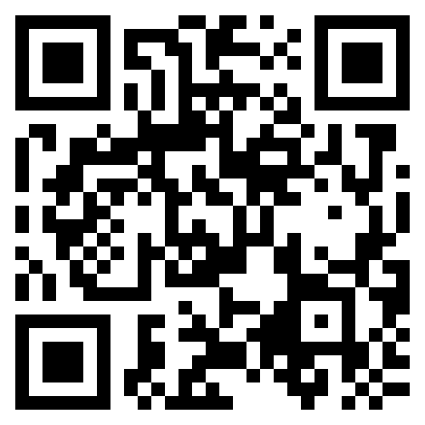
VIRTUAL ASSEMBLY FLYER TABLE:
SCAN ME
Download event flyers, agenda, minutes, financials etc.
OR to copy this link to open in a web browser:
https://tinyurl.com/yszyd9uz

Slide 3
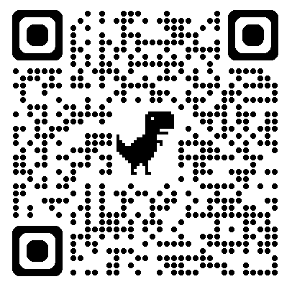
GENERAL SERVICE CONFERENCE INFO:
SCAN ME
Download or View past and present GSC information
OR to copy this link to open in a web browser:
https://area21aa.org/general-service-conference-information/
PW: Area21_GSC_041951

Slide 4
ONSITE ATTENDEES
Please mute your phone so that your personal calls, texts or notifications do not disrupt the assembly.
Please come to the mic to share with the assembly. Do not speak from your seat; your voice will not be picked up by the microphone and you can’t be heard by the others at the assembly, neither on site nor virtual.
To turn on the mic, firmly push the button at the bottom. Please Leave Mic on.
Keep in mind that that the mic can pick up ambient noise from the rest of the room. That can be distracting to virtual attendees. If you want to visit with a friend during the assembly, please move out into the vestibule.
If, when you come to the mic to speak you don’t want to be on camera, tell the camera operator. He can turn it off the so your image isn’t shared on Zoom.

Slide 5
ZOOM ATTENDEES
You have joined the assembly BUT the mics are off, so you can’t hear anything yet.
Please leave your mics off; your mic can pick up ambient noise from where you are and broadcast it to everyone else (on Zoom and on site). So. please keep your mic off, until your raise your hand to be recognized by the Chair to speak.
Please rename yourself in Zoom by First Name, Last Initial Service Position District No. That way other participants can put a name to a face.
If you are eligible to vote, add a * before your name to be more easily recognized by the chair.
To rename yourself, cursor up to the right corner of your image on Zoom, left click the three dots [...] and click on Rename and enter your info and click on Change.
Remember, if you leave Zoom and rejoin the assembly, you will have to rename yourself again.

Slide 6

ZOOM ATTENDEES (continued)
Renaming protocol for voting eligibility:
Rename Format
* = Vote eligible position, district, group, name
*ALT CHR, Tom H. | Area Officer | Eligible
*CC COR, Ed H. | Committee Chair | Eligible
*DCM 11, Luke S. | DCM District | Eligible
ALT DCM 11, Bart S. | Alt DCM District | DCM Present - Not Eligible
*GSR 11 Sobriety at 6, Tina T. | GSR District Group | GSR District - Eligible
ALT GSR 11 Sobriety at 6, Michael J. | ALT GSR District GSR Group | GSR Present - Not Eligible
*ALT GSR 11 Unthirsty Thursday, Steve S. | ALT GSR District GSR Group | GSR Not Present - Eligible
Brad P. | Member | Not Eligible
*PD P69 Bobby D. | Past Delegate | Eligible

Slide 7
THE AA SERENITY PRAYER
God, grant me the serenity to accept the things I cannot change; the courage to change the things I can and the wisdom to know the difference.

Slide 8
DECLARATION OF UNITY
This we owe to A.A.’s future:
to place our common welfare first, to keep our fellowship united.
For on A.A unity depend our lives and the lives of those to come

Slide 9
A.A. PREAMBLE
Alcoholics Anonymous is a fellowship of people who share their experience, strength and hope with each other that they may solve their common problem and help others to recover from alcoholism.
The only requirement for membership is a desire to stop drinking. There are no dues for A.A. membership; we are self-supporting through our own contributions. A.A. is not allied with any sect, denomination, politics, organization or institution; does not wish to engage in any controversy, neither endorses nor opposes any causes. Our primary purpose is to stay sober and help other alcoholics to achieve sobriety.
© A.A. Grapevine

Slide 10
G.S.R. PREAMBLE
We are the General Service Representatives.
We are the link in the chain of communication for our groups with the General Service Conference and the world of A.A.
We realize the ultimate authority is a loving God as he may express Himself in our Group Conscience.
As trusted servants, our job is to bring information to our groups in order that they can reach an informed group conscience.
In passing along this group conscience, we are helping to maintain the unity and strength so vital to our fellowship.
Let us, therefore, Have the patience and tolerance to listen while others share, The courage to speak up when we have something to share, And the wisdom to do what is right for our group and A.A. as a whole.

Slide 11
TRADITION ONE LONG FORM
Each member of Alcoholics Anonymous is but a small part of a great whole. A.A. must continue to live or most of us will surely die. Hence our common welfare comes first. But individual welfare follows close afterward.

Slide 12
TRADITION TWO LONG FORM
For our group purpose there is but one ultimate authority–a loving God as He may express Himself in our group conscience.

Slide 13
TRADITION THREE LONG FORM
Our membership ought to include all who suffer from alcoholism. Hence we may refuse none who wish to recover. Nor ought A.A. membership ever depend upon money or conformity. Any two or three alcoholics gathered together for sobriety may call themselves an A.A. group, provided that, as a group, they have no other affiliation.

Slide 14
TRADITION FOUR LONG FORM
With respect to its own affairs, each A.A. group should be responsible to no other authority than its own conscience. But when its plans concern the welfare of neighboring groups also, those groups ought to be consulted. And no group, regional committee, or individual should ever take any action that might greatly affect A.A. as a whole without conferring with the Trustees of the General Service Board. On such issues our common welfare is paramount.

Slide 15
TRADITION FIVE LONG FORM
Each Alcoholics Anonymous group ought to be a spiritual entity having but one primary purpose–that of carrying its message to the alcoholic who still suffers.

Slide 16
TRADITION SIX LONG FORM
Problems of money, property, and authority may easily divert us from our primary spiritual aim. We think, therefore, that any considerable property of genuine use to A.A. should be separately incorporated and managed, thus dividing the material from the spiritual. An A.A. group, as such, should never go into business. Secondary aids to A.A., such as clubs or hospitals which require much property or administration, ought to be incorporated and so set apart that, if necessary, they can be freely discarded by the groups. Hence such facilities ought not to use the A.A. name. Their management should be the sole responsibility of those people who financially support them. For clubs, A.A. managers are usually preferred. But hospitals, as well as other places of recuperation, ought to be well outside A.A.- and medically supervised. While an A.A. group may cooperate with anyone, such cooperation ought never go so far as affiliation or endorsement, actual or implied. An A.A. group can bind itself to no one.

Slide 17
TRAITION SEVEN LONG FORM
The A.A. groups themselves ought to be fully supported by the voluntary contributions of their own members. We think that each group should soon achieve this ideal; that any public solicitation of funds using the name of Alcoholics Anonymous is highly dangerous, whether by groups, clubs, hospitals, or other outside agencies; that acceptance of large gifts from any source, or of contributions carrying any obligation whatever, is unwise. Then too, we view with much concern those A.A. treasuries which continue, beyond prudent reserves, to accumulate funds for no stated A.A. purpose.

Slide 18
TRADITION EIGHT LONG FORM
Alcoholics Anonymous should remain forever non-professional. We define professionalism as the occupation of counseling alcoholics for fees or hire. But we may employ alcoholics where they are going to perform those services for which we may otherwise have to engage nonalcoholics. Such special services may be well recompensed. But our usual A.A. "12th Step" work is never to be paid for.

Slide 19
TRADITION NINE LONG FORM
Each A.A. group needs the least possible organization. Rotating leadership is the best. The small group may elect its secretary, the large group its rotating committee, and the groups of a large metropolitan area their central or intergroup committee, which often employs a full-time secretary. The trustees of the General Service Board are, in effect, our A.A. General Service Committee. They are the custodians of our A.A. Tradition and the receivers of voluntary A.A. contributions by which we maintain our A.A. General Service Office at New York. They are authorized by the groups to handle our over-all public relations and they guarantee the integrity of our principle newspaper, the A.A. Grapevine. All such representatives are to be guided in the spirit of service, for true leaders in A.A. are but trusted and experienced servants of the whole. They derive no real authority from their titles; they do not govern. Universal respect is the key to their usefulness

Slide 20
TRADITION TEN LONG FORM
No A.A. group or member should ever, in such a way as to implicate A.A., express any opinion on outside controversial issues–particularly those of politics, alcohol reform, or sectarian religion. The Alcoholics Anonymous groups oppose no one. Concerning such matters they can express no views whatever

Slide 21
TRADITION ELEVEN LONG FORM
Our relations with the general public should be characterized by personal anonymity. We think A.A. ought to avoid sensational advertising. Our names and pictures as A.A. members ought not be broadcast, filmed, or publicly printed. Our public relations should be guided by the principle of attraction rather than promotion. There is never need to praise ourselves. We feel it better to let our friends recommend us.

Slide 22
TRADITION TWELVE LONG FORM
And finally, we of Alcoholics Anonymous believe that the principle of anonymity has an immense spiritual significance. It reminds us that we are to place principles beforepersonalities; that we are actually to practice a genuine humility. This to the end that our great blessings may never spoil us; that we shall forever live in thankful contemplation of Him who presides over us all

Slide 23
CONCEPT ONE LONG FORM
The final responsibility and ultimate authority for A.A. world services should always reside in the collective conscience of our whole Fellowship.

Slide 24
CONCEPT TWO LONG FORM
When, in 1955, the A.A. groups confirmed the permanent charter for their General Service Conference, they thereby delegated to the Conference complete authority for the active maintenance of our world services and thereby made the Conference—excepting for any change in the Twelve Traditions or in Article 12 of the Conference Charter—the actual voice and the effective conscience for our whole Society.

Slide 25
CONCEPT THREE LONG FORM
As a traditional means of creating and maintaining a clearly defined working relation between the groups, the Conference, the A.A. General Service Board and its several service corporations, staffs, committees and executives, and of thus insuring their effective leadership, it is here suggested that we endow each of these elements of world service with a traditional “Right of Decision.”

Slide 26
CONCEPT FOUR LONG FORM
Throughout our Conference structure, we ought to maintain at all responsible levels a traditional “Right of Participation,” taking care that each classification or group of our world servants shall be allowed a voting representation in reasonable proportion to the responsibility that each must discharge.

Slide 27
CONCEPT FIVE LONG FORM
Throughout our world service structure, a traditional “Right of Appeal” ought to prevail, thus assuring us that minority opinion will be heard and that petitions for the redress of personal grievances will be carefully considered.

Slide 28
CONCEPT SIX LONG FORM
On behalf of A.A. as a whole, our General Service Conference has the principal responsibility for the maintenance of our world services, and it traditionally has the final decision respecting large matters of general policy and finance. But the Conference also recognizes that the chief initiative and the active responsibility in most of these matters should be exercised primarily by the Trustee members of the Conference when they act among themselves as the General Service Board of Alcoholics Anonymous.

Slide 29
CONCEPT SEVEN LONG FORM
The Conference recognizes that the Charter and the Bylaws of the General Service Board are legal instruments: that the Trustees are thereby fully empowered to manage and conduct all of the world service affairs of Alcoholics Anonymous. It is further understood that the Conference Charter itself is not a legal document: that it relies instead upon the force of tradition and the power of the A.A. purse for its final effectiveness.

Slide 30
CONCEPT EIGHT LONG FORM
The Trustees of the General Service Board act in two primary capacities: (a) With respect to the larger matters of over-all policy and finance, they are the principal planners and administrators. They and their primary committees directly manage these affairs. (b) But with respect to our separately incorporated and constantly active services, the relation of the Trustees is mainly that of full stock ownership and of custodial oversight which they exercise through their ability to elect all directors of these entities.

Slide 31
CONCEPT NINE LONG FORM
Good service leaders, together with sound and appropriate methods of choosing them, are at all levels indispensable for our future functioning and safety. The primary world service leadership once exercised by the founders of A.A. must necessarily be assumed by the Trustees of the General Service Board of Alcoholics Anonymous.

Slide 32
CONCEPT NINE SHORT FORM
Good service leadership at all levels is indispensable for our future functioning and safety.
Primary world service leadership, once exercised by the founders, must necessarily be assumed
by the trustees.

Slide 33
CONCEPT TEN LONG FORM
Every service responsibility should be matched by an equal service authority - the scope of such authority to be always well defined whether by tradition, by resolution, by specific job description or by appropriate charters and bylaws.

Slide 34
CONCEPT ELEVEN LONG FORM
While the Trustees hold final responsibility for A.A.’s world service administration, they should always have the assistance of the best possible standing committees, corporate service directors, executives, staffs, and consultants. Therefore the composition of these underlying committees and service boards, the personal qualifications of their members, the manner of their induction into service, the systems of their rotation, the way in which they are related to each other, the special rights and duties of our executives, staffs, and consultants, together with a proper basis for the financial compensation of these special workers, will always be matters for serious care and concern.

Slide 35
CONCEPT TWELVE LONG FORM
General Warranties of the Conference: in all its proceedings, the General Service Conference shall observe the spirit of the A.A. Tradition, taking great care that the Conference never becomes the seat of perilous wealth or power; that sufficient operating funds, plus an ample reserve, be its prudent financial principle; that none of the Conference Members shall ever be placed in a position of unqualified authority over any of the others; that all important decisions be reached by discussion, vote, and, whenever possible, by substantial unanimity; that no Conference action ever be personally punitive or an incitement to public controversy; that, though the Conference may act for the service of Alcoholics Anonymous, it shall never perform any acts of government; and that, like the Society of Alcoholics Anonymous which it serves, the Conference itself will always remain democratic in thought and action.

Slide 36
WHO CAN VOTE?
(AREA HANDBOOK SECT. 8.4 [PG. 21)
The voting membership of the Southern Illinois Area General Service Assembly is composed of the following persons: Area Chair, Alternate Area Chair, Area Delegate, Alternate Area Delegate, Area Treasurer, Area Recording Secretary, Area Registrar, and past Area 21 Delegates as well as past delegates of other areas currently residing in Area 21. Committee Chairs of Archives, CPC, Corrections, Grapevine, GSR Workshop, Literature, PI, Structures and Policy, Treatment, and Webmaster Committees, are also eligible to vote. District Committee Members (DCMs) and the General Service Representatives (GSRs)-or in their absence, their Alternates, are also eligible to vote.

Slide 37
SIMPLE MAJORITY OR
SUBSTANTIAL UNANIMITY
SIA Area 21 Handbook Section 8.4: “All important decisions are to be discussion, vote and wherever possible, by substantial unanimity.”
This practice reflects Warranty Four of Concept XII of the 12 Concepts for World Service.
Just before a vote on a motion, the Chair will inform the Assembly whether the motion requires a simple majority to pass or if it requires substantial unanimity to pass..

Slide 38
MINORITY OPINION
After a vote on a contentious issue, the chair will ask for the minority opinion to be heard. This is done so the Area’s action is not in conflict with Concept 5 of the 12 Concepts for World Service: Right of Appeal.
From the Area 21 SIA Handbook, Section 8.4.3:
“Once a vote has been conducted, the Chairperson will call for the “Minority Opinion.” At this juncture, all who wish to speak against the vote just taken are invited and encouraged to do so. During Minority Opinion sharing, no member may speak to issue from the standpoint of the majority. Minority opinion is only for the expression of the minority opinion.
After sharing of the Minority Opinion, the Chairperson will ask if anyone who voted with the majority wishes to change their vote. If anyone in the majority has changed their mind on the issue, the Chair will preside over another vote on the motion. If the motion is again passed, the vote stands. If the motion is defeated during the second vote, it is defeated entirely.”
NOTE: the General Service Conference uses a different procedure. It is described in the A.A. Service Manual 2021-2023 edition, pg. 166.

Slide 39
ZOOM BASICS & VOTING
Make sure your Zoom client is updated to the latest version.
Under settings select “Always show meeting controls”
Phone: swipe left on the tool bar then 3 dots then meeting settings.
Computer: from the client select user icon top left then settings
To raise / lower your hand: (To be recognized by the chair)
Phone: Push *9
Smartphone:Tap the screen, then cursor to the three dots ... [More] at the bottom of the edge of the screen. then click on Raise hand /lower hand.
Computer / tablet: Cursor to the bottom of the screen. Selection Reactions and click on the hand icon.
OR using your keyboard Alt + Y (Windows) Option + Y (Mac)
For anonymous voting please wait for the poll to start. If your platform doesn't show Polls, please text your response to: 217-825-7595 Tim or xxx-xxx-xxxx XXXX

Slide 40


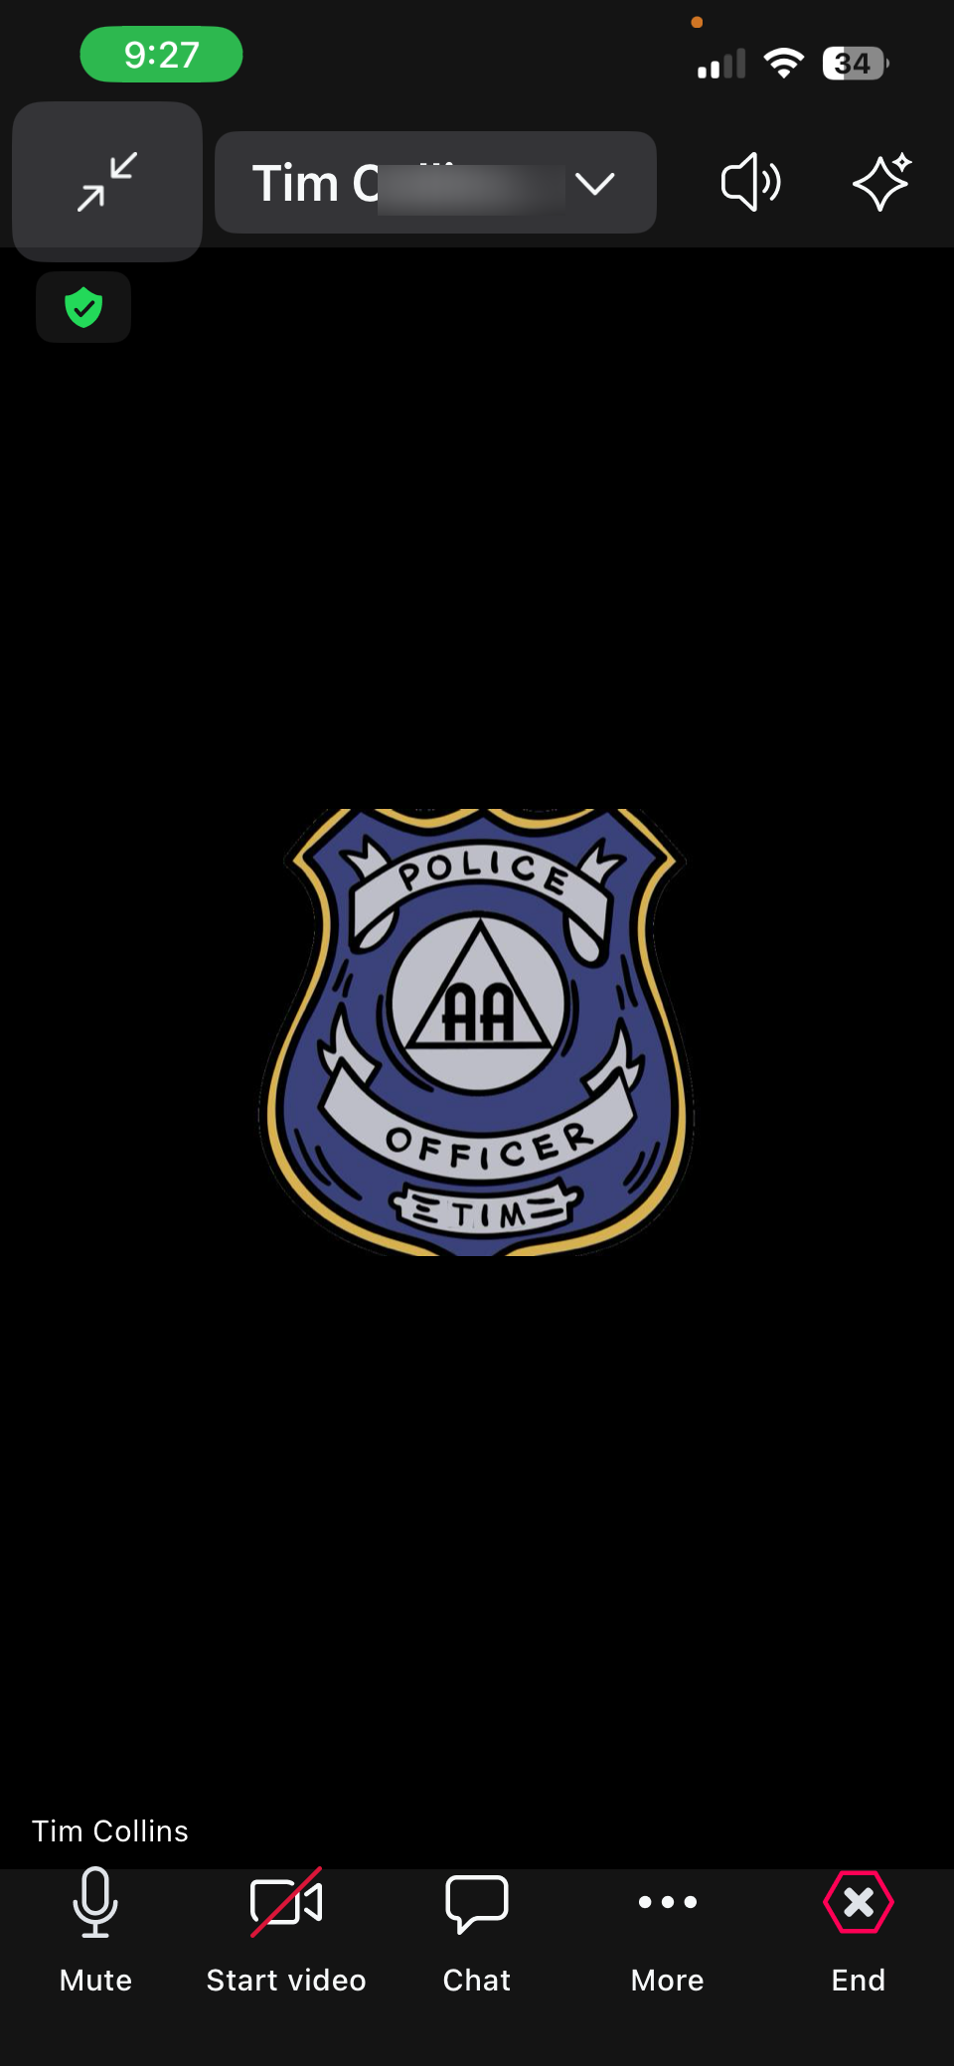
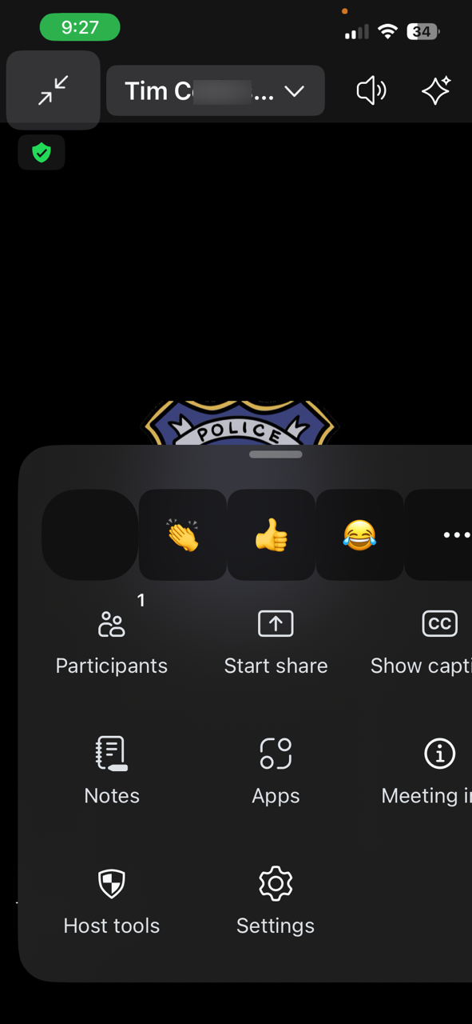
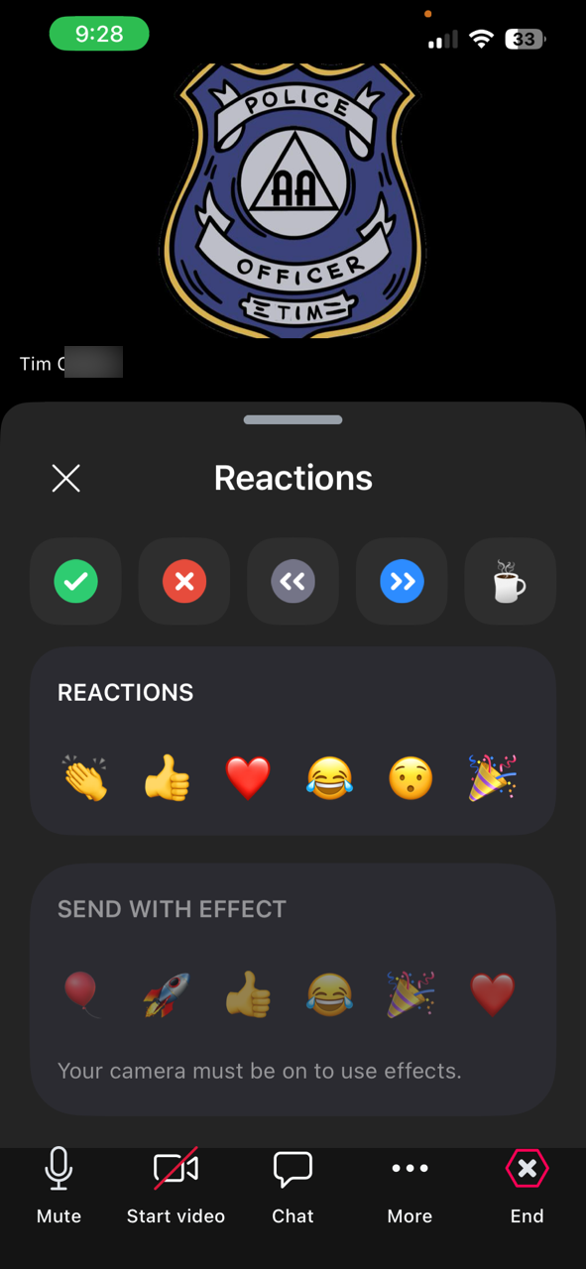
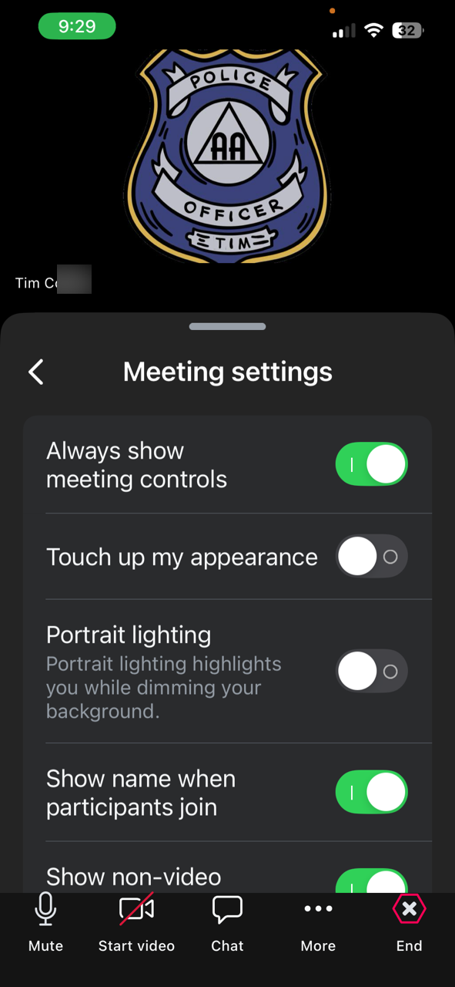
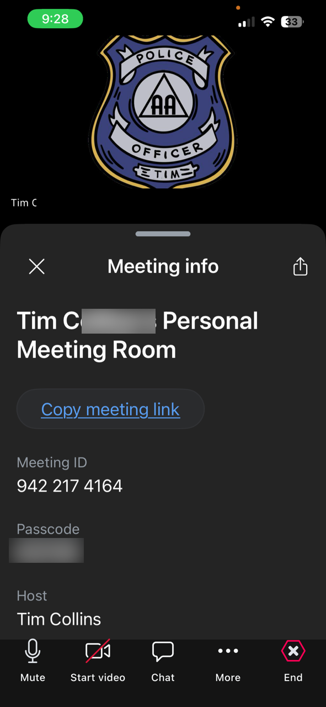
ZOOM BASICS & VOTING
Please only use the yes x or no x reactions for simple voting, choose only one. (the host will clear the results)
Polls will appear automatically.
Text to a friend.

Slide 41
2025-2026 AREA 21 OFFICERS (PANEL 75)
Position | Name | Email | Phone
Chair | Tom H. | tchensold@frontier.com | 618-580-1118
Alternate Chair | Vacant
Delegate | Jodi B. | jodibsia21@gmail.com | 920-737-4000
Alternate Delegate | Pam B. | pamb4kids@gmail.com | 217-855-7856
Registrar | Thom J. | area21registrar@gmail.com | 309-862-1674
Recording Secretary | Karen D. | secretarysia21@gmail.com | 217-891-0308
Treasurer | Leo S. | storkleo@gmail.com | 217-652-8370

Slide 42
2025-2026 AREA 21 COMMITTEE CHAIRS (PANEL 75)
Committee | Chair | Email | Phone
Area Archivist / Archives | Carl M. | cdmizell76@aol.com | 618-920-7957
Corrections- | Ed H. | corrections@aa-eci.org | 618-317-7281
Corrections | Jeff D. | correctionssia21@gmail.com; jeffdale255@gmail.com | 618-444-9848
PI | Laura K. | publicinformationa21@gmail.com | 402-689-3553
Grapevine | Gordon N. | grapevinesia21@gmail.com | 618-978-7974
GSR Workshop | Paula E. | delp65sia21@gmail.com | 618-910-0047
Literature | Robert S. | litsia21@gmail.com | 618-791-0195
CPC | Michael R. | mjreeves23@gmail.com | 217-361-5015
Structure & Policy | Dean S. | delp59sia21@gmail.com | 217-622-1315
Treatment | Vacant
Website & Technology | Karin S. | aaarea21.web@gmail.com | 618-530-0486

Slide 43
Area 21 Past Delegates 2023-2024
Panel | Name | Email | Phone
73 | Tom H. | tchensold@frontier.com | 618-525-4578
71 | Gordon N. | gordonsia21@gmail.com | 618-580-1118
69 | Bobby D. | bobbydsia21@gmail.com | 618-889-2723
67 | Pat W. | delps67sia21@gmail.com | 309-337-8219
65 | Paula E. | delp65sia21@gmail.com | 618-910-0047
63 | Becky B. | bburdensia21@gmail.com | 309-319-0839
61 | Fariba M. | fariba.murray@gmail.com | 309-310-5644
59 | Dean S. | delp59sia21@gmail.com | 217-622-1315
55 | Carl M. | cdmizell76@aol.com | 618-920-7957
51 | Richard G. |  | 217-259-3222
Area 38 / Panel 53 | Mike F. | mfoster762@aol.com | 314-640-0513

Slide 44
NEW BUSINESS - On the Agenda for a Vote
Area to reimburse Rich H. for travel expenses, to chair Area 21 elections.

Slide 45
INTRODUCTION OF DCMS
AND DCM REPORTS; GSRs AND GSR REPORTS
DCMs: 4 min each
GSRs: 2 min each
To be included in minutes, also use report form on the Area 21 website and email to secretarysia21@gmail.com

Slide 46
DCMs Page 1 of 3
Position | Name | Email | Phone
Dist. 4 DCM | Inactive
Dist. 5 DCM | Stephen M. | steveeplb@gmail.com | 217-430-0144
Dist. 5 Alt DCM | Nicole D. | nicoledenier.15@gmail.com
Dist. 6 DCM | Robin S. | rgeiger54@icloud.com | 937-684-5388
Dist. 6 DCM | Joe N.
Dist. 7 DCM | Gordon R. | gordon9@icloud.com | 618-214-5262
Dist. 7 Alt DCM | Rick B. | rick_saccwk@hotmail.com | 618-214-9344
Dist. 8 DCM | Inactive
Dist. 9 DCM | Inactive
Dist. 10 DCM | MIke H. | mghope@frontier.net | 309-838-2918
Dist. 10 Alt DCM | Mike T. | michaeltunt@gmail.com

Slide 47
DCMs Page 2 of 3
Position | Name | Email | Phone
Dist. 11 DCM | Tim C. | timc7595@gmail.com | 217-825-7595
Dist. 11 Alt DCM | Alex T. | atorresfitter@gmail.com | 954-200-4924
Dist. 12 DCM | Linda Z. | dcm@aa-eci.org | 217-778-2752
Dist. 12 Alt DCM | Liza WS. | alt-dcm@aa-eci.org | 225-892-3488
Dist. 13 DCM | Warren S. | warrenschroeder1962@icloud.com | 217-690-1035
Dist. 13 Alt DCM | Kat S. | katswaton@gmail.com | 607-382-6567
Dist. 14 DCM | Megan G. | dcm.d14.a21@gmail.com | 618-580-4777
Dist. 14 Alt DCM |  | altdcm.d14.a21@gmail.com
Dist. 15 DCM | Bob K. | godivefish@gmail.com | 217-370-5890
Dist. 15 Alt DCM | John L. | lacyjohn90@gmail.com | 217-320-2916

Slide 48
DCMs Page 3 of 3
Position | Name | Email | Phone
Dist. 16 DCM | William W. | billangel6570@gmail.com | 812-263-5229
Dist. 16 Alt DCM | Tom W. | wehrheitom.09@gmail.com
Dist. 17 DCM | Dave S. | dsamples65@outlook.com | 618-663-5015
Dist. 17 Alt DCM | Jane L. | janeandlexi@yahoo.com | 618-889-6018
Dist. 18 DCM | John G. | Jgaubatz5150@att.net | 618-541-2543
Dist. 18 Alt DCM | Joe V. | joevalencia57@icloud.com | 618-578-9425
Dist. 19 DCM | Trevor P. | tplanck@gmail.com | 217-820-9866
Dist. 19 Alt DCM | Ryan McC | rjm0587@gmail.com | 217-415-6326
Dist. 20 DCM | Nancy W. | nan@yahoo.com | 224-434-9416
Dist. 20 Alt DCM

Slide 49

10 MINUTE BREAK
MORE TO COME

Slide 50
RECORDING SECRETARY
Minutes of March 2026 Assembly
Karen D. Share:
March 2026 Area Assembly
Unapproved Minutes
Requires Motion & Second to Vote to Approve

Slide 51
RECORDING SECRETARY
Minutes of June 2026 Assembly
Karen D. Share:
June 2026 Area Assembly
Unapproved Minutes
Requires Motion & Second to Vote to Approve

Slide 52
TREASURER'S REPORT
Leo S.
Screen Share
Report emailed June 2026 &
on Virtual Flyer Table
Requires Motion & Second to Vote to Approve

Slide 53
Contribution to Southern Illinois Area 21
Group Name: __________________________________________
City: ___________________________ District Number: ________
Group Service Number: ________________
Contact Name:__________________________________________
Contact (Phone or email): _________________________________
Contribution Amount: $___________ Check Number: __________
Remit to:
Southern Illinois Area 21
P.O. Box 9226 Springfield, IL 62791

Slide 54
REGISTRAR’S REPORT
Thom J.
Does Not Require Motion to Approve
IF YOU ARE AN AREA OFFICER, AREA COMMITTEE CHAIR, DCM, ALTERNATE DCM, GSR, ALTERNATE GSR or DISTRICT COMMITTEE CHAIR. PLEASE MAKE SURE THAT THE REGISTRAR HAS YOUR EMAIL ADDRESS AND INFORMATION SO THAT YOU WILL RECEIVE VITAL COMMUNICATION

Slide 55
ALTERNATE AREA CHAIR REPORT
June 7, 2026
Warren S.

Slide 56
AREA CHAIR REPORT
Does Not Require Motion to Approve
Sept 13, 2026
Tom H.

Slide 57
ALTERNATE DELEGATE REPORT
Does Not Require Motion to Approve
Sept 13, 2026
Pam B.

Slide 58
DELEGATE REPORT
Does Not Require Motion to Approve
Sept 13, 2026
Jodi B.
Document version on Virtual Flyer Table.

Slide 59
AREA 21 ELECTIONS
Elections for Panel 77 Officers of Area 21
Delegate, Alternate Delegate, Chair, Registrar, Treasurer, Secretary, Alt. Chair

Slide 60
THIRD LEGACY PROCEDURE
FROM
THE A.A. SERVICE MANUAL
combined with
TWELVE CONCEPTS
FOR WORLD SERVICE
2021-2023 Edition
REVISED AND UPDATED
APPENDIX G PAGES 110-111

Slide 61
APPENDIX G:
THIRD LEGACY PROCEDURE
PURPOSE
A.A.’s Third Legacy Procedure is a special type of electoral procedure, used primarily for the election of delegates and regional and at-large trustees. It is considered to be unique to A.A., and at first glance, appears to introduce a strong element of chance into a matter that should depend solely on the judgment of the majority. In practice, however, it has proved highly successful in eliminating the influence of factions or parties that seem to thrive on most political scenes. The railroading of a candidate for election is made difficult, if not impossible, since voters have a wide selection of candidates to choose from. More importantly, a second-place candidate who may be extremely well qualified but without early popular support is encouraged to stay in the balloting rather than withdraw.

Slide 62
PROCEDURE (1 of 3)
1. The names of eligible candidates are posted on a board. All voting members (of the area or Conference body) cast written ballots, one choice to a ballot. The tally for each candidate is posted on the board.
              The first candidate to receive two-thirds of the total vote is elected.
2. Withdrawals start after the second ballot. If any candidate has less than one-fifth of the total vote, his or her name is automatically withdrawn — except that the top two candidates must remain. (In case of ties for second place, the top candidate and all tied runners-up remain as candidates.)

Slide 63
PROCEDURE (2 of 3)
3. After the third ballot, candidates with less than one-third of the total vote will be withdrawn automatically, except the two top candidates remain. (In case there are ties for second place, the top candidate and all tied runners-up remain as candidates.)
4. After the fourth ballot, if no candidate has two-thirds of the total vote, the candidate with the smallest total is automatically withdrawn, except that the top two candidates remain. In case there are ties for second place, the top candidate and all tied second-place candidates remain.
At this point, the chairperson asks for a motion, second, and a simple majority of hands on conducting a fifth and final ballot.
If this motion is defeated, balloting is over and the choice is made by lot — “going to the hat” — immediately.
If the motion carries, a fifth and final ballot is conducted.

Slide 64
PROCEDURE (3 of 3)
5. If after the fifth ballot no election occurs, the chairperson announces that the choice will be made by lot (from the hat). At this point, the top two candidates remain. In case there are ties for first place, all tied first place candidates remain. In case there are no ties for first place, the top candidate and any tied second-place candidates remain.
6. Lots are then drawn by the teller, and the first one “out of the hat” is the delegate (or trustee or other officer).

Slide 65
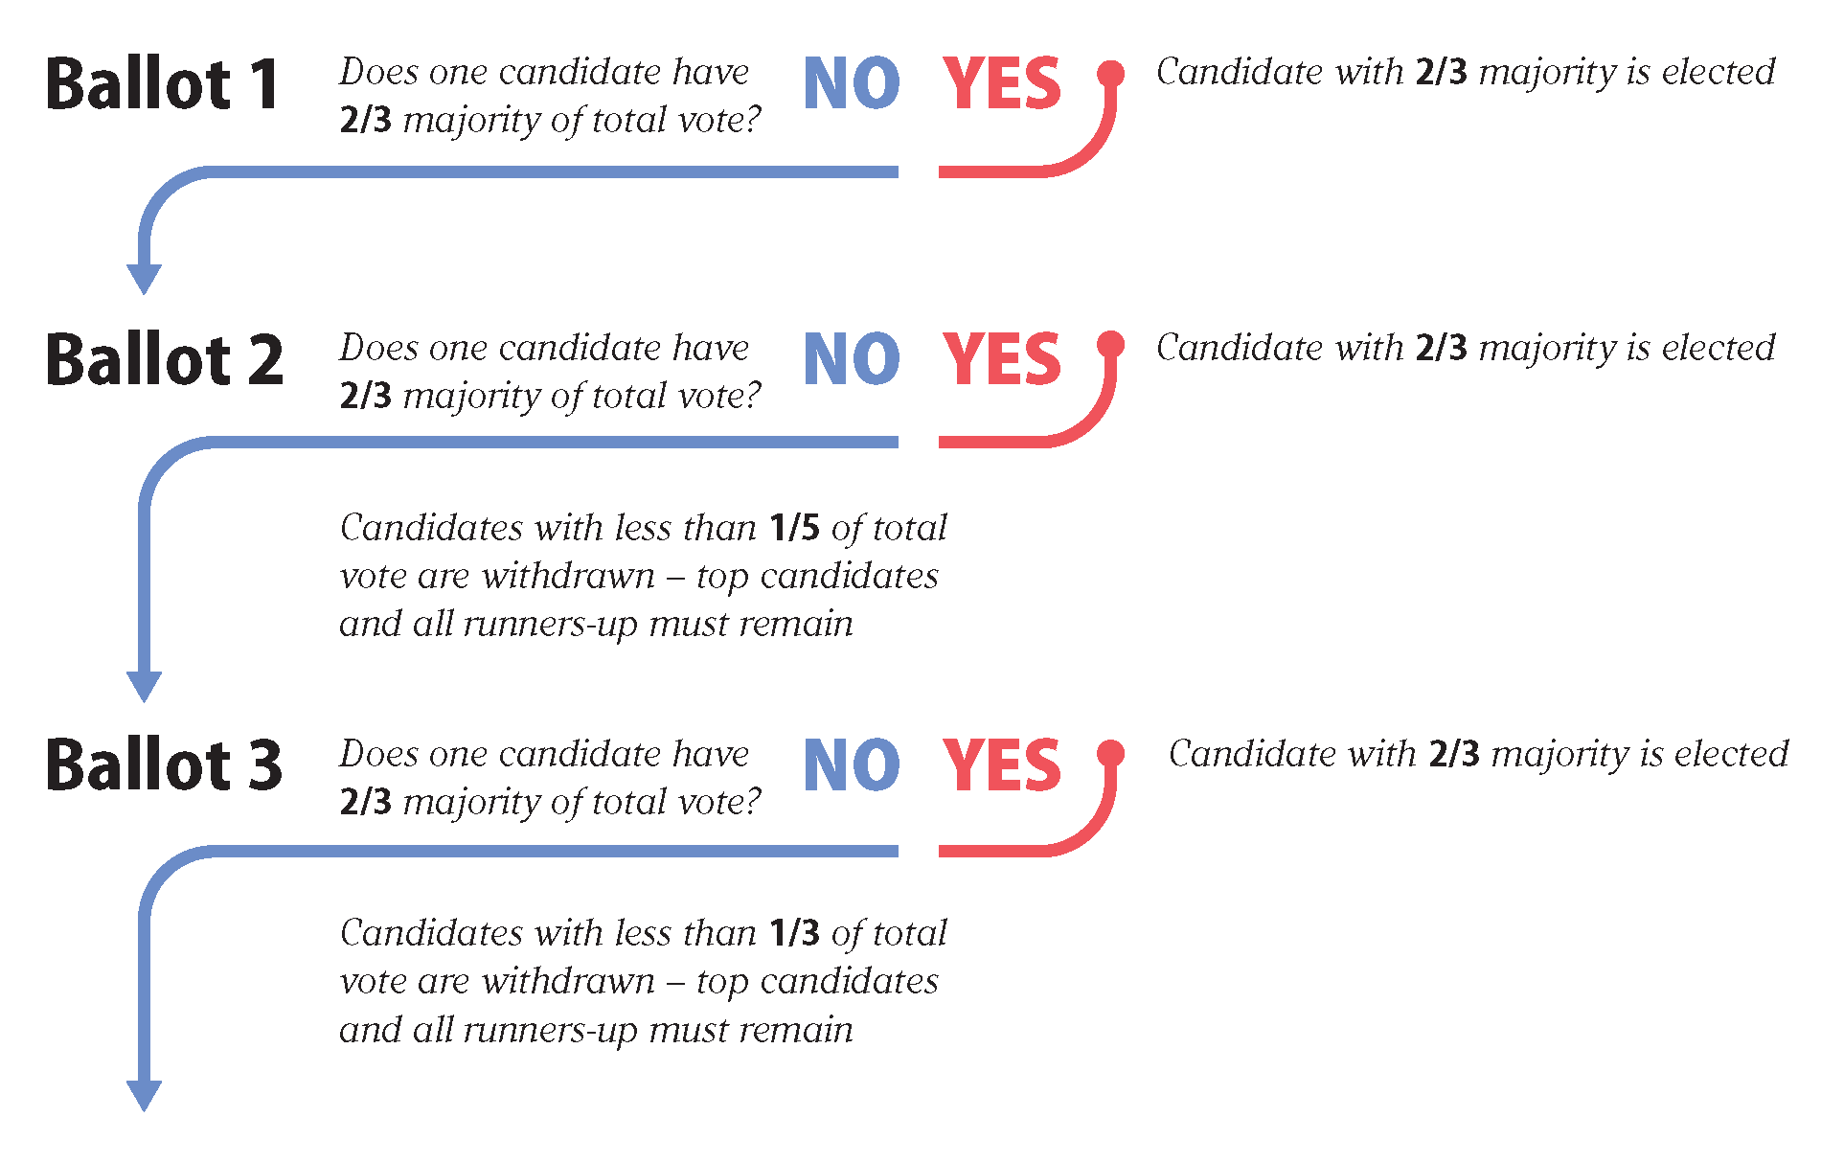

Slide 66
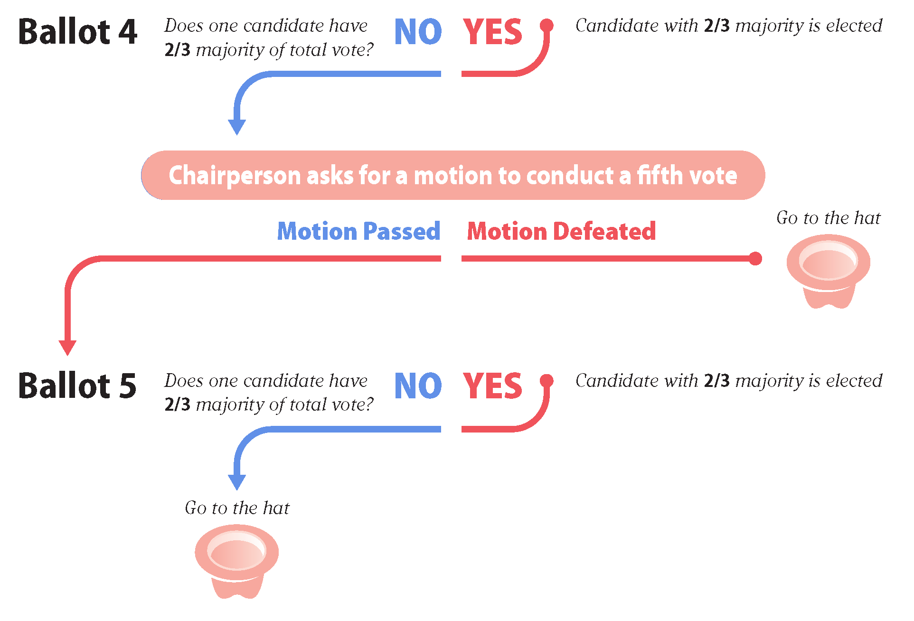

Slide 67
Area 21 Officer Qualifications
(approved at March 2021 Area Assembly)
Those eligible to stand for election for Area Delegate, Alternate Area Delegate, Area Chair, and Alternate Area Chair are current or former District Committee Members residing in Area 21.
Those eligible to stand for election for Area Treasurer, Area Recording Secretary, and Area Registrar, are members of Alcoholics Anonymous residing in Area 21 who have 5+ years of sobriety.
Past Delegates are eligible to stand for election as Area Chair or Alternate Chair.
It is strongly recommended that SIA21 elected Trusted Servants and SIA21 appointed Committee Chairs not simultaneously hold a Group or District position that has a vote, or potential vote, at SIA21 Assemblies.

Slide 68
5.1 Elections (page 1 of 4)
The Area elects the following Trusted Servants: Area Delegate, Alternate Area Delegate, Area Chair, Alternate Area Chair, Area Treasurer, Area Recording Secretary, and Area Registrar.
The outgoing Delegate fills the position of Area Chair.
All positions are for a term of two years, beginning on January 1 of odd numbered years.
The suggested qualifications for the elected officers are as stated in The A.A. Service Manual, pages S44 through S46.
The election for Offices is conducted according to the Third Legacy Procedure, as detailed in the A.A. Service Manual, page S21. Elections are held during the September Assembly of even numbered years.
When an elected officer is unable to complete his or her term, a special election is held at the next Assembly.

Slide 69
5.1 Elections (page 2 of 4)
In addition to the elected officers, the following appointed positions are filled by the Area Chair: Archives Committee Chair, Cooperation with the Professional Community (CPC) Chair, Corrections Chair, Grapevine Chair, GSR Workshop Chair, Literature Chair, Public Information (PI) Chair, Structure and Policy Chair, Treatment Facilities Chair, and Web Services Chair.
To avoid having to move the Archives frequently, the Area Archivist is a semi-permanent position.
All appointed positions carry a two-year term running concurrently with the elected officer's terms.

Slide 70
5.1 Elections (page 3 of 4)
The Area Committee is composed of the elected Officers, Committee Chairs, and the District Committee Members.
Any meeting of the area GSRs and the Area Committee is an Assembly.
Persons allowed a vote at Area Assemblies, including Elections by the Third Legacy Procedure are: all GSRs, the Area Committee, and Past Delegates.
Alternate GSRs and Alternate DCMs are allowed to vote if their GSR or DCM is absent.
In the spirit of rotation, no elected Officer or appointed Trusted Servant should be elected to two full terms of the same position; however, an individual may complete another individual's term and run for election to that position at the next election.

Slide 71
5.1 Elections (page 4 of 4)
Those eligible to stand for election for Area Delegate, Alternate Area Delegate, Area Chair, and Alternate Area Chair are current or former District Committee Members residing in Area 21.
Those eligible to stand for election for Area Treasurer, Area Recording Secretary, and Area Registrar, are members of Alcoholics Anonymous residing in Area 21 who have 5+ years of sobriety. Past Delegates are eligible to stand for election of Area Chair or Alternate Chair only. It is strongly recommended that SIA21 elected Trusted Servants and SIA21 appointed Committee Chairs not simultaneously hold a Group or District position that has a vote, or potential vote, at SIA21 Assemblies.

Slide 72
5.4 Area Delegate (page 1 of 4)
The Delegate's main responsibility is to represent the Area at the General Service Conference each spring and report the actions of the Conference back to the Area.
The Delegate
  presents a report to the Area at each Assembly
  is responsible for maintaining contact with the individual Districts
  communicating the wishes of the Area to the General Service Office.
The Delegate is required to attend the East Central Regional Conference and the East Central Region Conference of Delegates Past and Present and is a member of the Illinois State Conference Policy Committee.

Slide 73
5.4 Area Delegate (page 2 of 4)
Duties include those indicated in the A.A. Service Manual, Chapter 6, and specifically, the Delegate should:
  Maintain regular and frequent contact and report on the workings of the General Service Office, A.A. Grapevine Office, A.A. World Services Board, General Service Board, andA.A. Grapevine Board.
  Attend the annual meeting of the General Service Conference, bringing forward the viewpoints and experience of Area 21 to the Conference.
  Present the Conference Report at the Spring Conference Assembly and encourage Committee Members to pass on this information to Groups and Intergroups/Central Service offices. (A one-hour report is recommended.)
  Present the Conference Report to groups and districts.
  Attend and participate in the East Central Regional Forum.

Slide 74
5.4 Area Delegate (page 3 of 4)
  Attend and participate in the East Central Region Conference of Delegates Past and Present.
  Attend and participate in service-related workshops within Area 21 when asked and able to do so.
  Help area committees obtain financial support for the Area and GSO.
  Provide leadership in solving local problems involving the A.A. Traditions.
  Remind GSRs to inform groups and individuals about the A.A. Grapevine and Conference-approved literature.
  Cooperate with GSO in obtaining information—for example, by making sure that updated information reaches GSO in time to meet the deadline for each issue of the A.A. Directory and helping carry out the triennial Membership Surveys.

Slide 75
5.4 Area Delegate (page 4 of 4)
  Work closely with Committee Members and Officers, sharing experience throughout the year. After GSRs and Committee Members have reported on the Conference, learn from these A.A.s how the groups and members have reacted.
  Assume added responsibility if the Area Chair and Alternate Area Chair are unable to serve.
  Keep the Alternate Area Delegate fully informed and active so that the Alternate can replace the Delegate in an emergency.
  Late in the second year, works with newly elected Delegate to pass along a basic knowledge of Conference proceedings and problems.

Slide 76
5.5 Alternate Area Delegate (page 1 of 3)
The Alternate Delegate is required to assume the responsibilities of Delegate in the event that the elected Delegate is unable to perform his or her duties.
The Alternate Delegate is required to represent the Area at the Illinois State Conference, East Central Regional Conference and the East Central Region Conference of Delegates Past and Present each year, and the East Central Regional Forum in alternating years. This officer’s signature is included on the Area bank account’s signature card for emergency use only.

Slide 77
5.5 Alternate Area Delegate (page 2 of 3)
Specifically, the Alternate Delegate should:
    Assist the Area Delegate in the performance of his or her duties.
    Attend and participate in Area Assemblies, Area Conference, and the Area’s Delegate’s Workshop.
    Attend and participate in the East Central Regional Conference and report on it at the next Area Assembly.
    Attend and participate in the East Central Regional Forum and report on it at the next Area Assembly.
    Attend and participate in the East Central Region Conference of Delegates Past and Present and report on this conference at the next Assembly.
    Attend and participate in the Illinois State Conference and report on it at the next Assembly.

Slide 78
5.5 Alternate Area Delegate (page 3 of 3)
    Attend and participate in service-related workshops within Area 21 when asked and able to do so.
    Set up and take down the Area A/V equipment, the framed photos of Bill, Bob, Lois, and Ann, and the Conference Banner at Area events where use and display are necessary. These items will be obtained from the Area Archivist.
    Perform any duties relevant to office as documented in The A.A. Service Manual or Area 21 Assembly Actions.

Slide 79
5.2 Area Chair (page 1 of 3)
This Officer's primary responsibility is to prepare the agenda and preside over the Area Assembly, conducting the meetings in an orderly fashion. The Area Chair's responsibilities also include appointing the Committee Chairs, representing the Area in meetings of the Illinois State Conference Committee, and representing the Area at the East Central Region Conference of Delegates Past and Present, and the East Central Regional Conference.
This officer’s signature is included on the area bank account signature card for emergency use only.

Slide 80
5.2 Area Chair (page 2 of 3)
Specifically, the Area Chair should:
  Provide leadership, organization, and communication within the Area Service Structure, toward the end of fulfilling A.A.'s primary purpose.
  Chair Area 21 Assemblies:
      At the September Assembly, in even-numbered years, conduct elections for the Area Officers in accordance with Third Legacy Procedures as defined in The A.A. Service Manual. Votes are cast by use of prepared ballot forms.
      Conducts elections for nominees for East Central Regional (ECR) Trustee and Trustee-at-Large that may take place within his or her term.
  Notify the Area Committee of scheduled Area Committee meetings and Assemblies.
  Attend and participate in the Area 21 Assemblies, Illinois State Conference, and East Central Region Conference of Delegates Past and Present.
  Attend and participate in the East Central Regional Conference.

Slide 81
5.2 Area Chair (page 3 of 3)
  Attend and participate in the East Central Regional Forum.
  Attend and participate in applicable Local Forums.
  Attend and participate in service-related workshops within Area 21 when asked and able to do so.
  Cooperate with the Area Delegate in helping groups or districts solve problems.
  Be one of the authorized signers for the Area 21 checking account.
  Create Area 21 Events Calendar for Upcoming Year. Send to Webmaster for posting on the Area 21 website. Provide copies of the Events Calendar to the March Area Assembly.
  Keeps the Alternate Chair fully informed and active, so that the Alternate can replace the Chair in an emergency.
  Perform duties relevant to office, as documented in The A.A. Service Manual or Area 21 Assembly Actions.

Slide 82
5.8 Area Registrar (page 1 of 3)
The Registrar facilitates General Service Office contact and communications with Districts, Committee Chairs, GSRs, and Groups by maintaining the FNV database through a VPN connection to the General Service Office. This Office requires a working knowledge of database, spreadsheet, and mail merge software, as well as a personal computer with Internet connection and pertinent software for effective completion of the duties necessary. The Area Registrar is responsible for maintaining Area communication lists necessary for email and mail of Area information to Trusted Servants, Districts, and Groups within Area 21.

Slide 83
5.8 Area Registrar (page 2 of 3)
Specifically, the Area Registrar should:
    Attend and participate in Area Assemblies.
    Provide copies of the Area Directory of Trusted Servants List to the participants.
    Present written reports of Groups, GSRs (primary contacts), and meeting locations and times to the DCMs; and requests corrections for contacts through submission of Group Information Change Forms.
    Facilitate registration of new Groups by electronic interface with the General Service Office FNV database. Required information should be provided on New Group Information Forms.

Slide 84
5.8 Area Registrar (page 3 of 3)
    Email copies of Area minutes to all contacts on the Area Directory, and any other A.A. member that requests the minutes.
    Email Area Assembly Agendas, Event Flyers, and other information concerning Area meetings to Area Trusted Servants, DCMs, and GSRs in a timely manner.
    Provide information on group locations to assist maintenance of the Area 21 map.
    Maintain electronic and hard copies of files, as necessary, for the effective completion of relevant duties of the office, as documented in The A.A. Service Manual or Area 21 Assembly Actions.

Slide 85
5.6 Area Treasurer (page 1 of 3)
The Area Treasurer acts as the trustee for Area funds and controls the Area bank account, accepts the contributions from the groups in the Area, and pays the Area's bills. The Treasurer is required to present a report of income and expenses at the Area Assembly each quarter, developing a yearly budget, and present it at the December Assembly.

Slide 86
5.6 Area Treasurer (page 2 of 3)
Specifically, the Treasurer should:
    Maintain a checking account for the Area General Fund and be one of the authorized signers for the Area 21 checking account.
    Maintain a convenient, dedicated Southern IL Area 21 Post Office Box, and notify the Assembly and Groups of the postal address.
    Deposit all contributions and send acknowledgement thank you notes to the contributors.
    Attend Area Assemblies and present written financial reports documenting contributions by source, and expenses by check issued, which occurred since the previous Assembly.
    Pay all bills and other authorized disbursements in a timely manner. Bills paid and expense reimbursements should be summarized in a Chart of Accounts on a quarterly basis, with an annual summary.

Slide 87
5.6 Area Treasurer (page 3 of 3)
    Receive proposed annual budgets from Area Officers and Standing Committee Chairs for development of an Annual Budget.
    Develop an Annual Budget which provides adequate detail for anticipated Area 21 Expenses by Office, Committee Chairs, Scheduled Events, rents, fees, and miscellaneous. The Budget shall consider annual contributions and prudent reserves.
    Attend and participate in the Area Assemblies, Area Conference, and Area Delegate’s Workshop.
    Implement and maintain spreadsheet-style accounting tools for the management of the Area's financial affairs. Financial Records and Reports should be electronically transferable to future holders of the Office of Treasurer.
    Responsible for encouraging financial support for the Area and GSO.
    Performs any duties relevant to office, as documented in The A.A. Service Manual and Area 21 Assembly Actions.

Slide 88
5.7 Area Recording Secretary (page 1 of 2)
The Area Recording Secretary is responsible for taking the minutes of the Area Assemblies, compiling them in an orderly fashion, and forwarding them to the Area Registrar for timely distribution. This officer is also responsible for those clerical jobs as are necessary for the operation of the Area's business. Additionally, the Secretary maintains a chronological list of passed Area motions and actions.

Slide 89
5.7 Area Recording Secretary (page 2 of 2)
Specifically, the Secretary should:
    Attend and participate in the Area Assemblies, Area Conference and the Area Delegate’s Workshop.
    Record the meetings of Area Assemblies to assist in the preparation of the minutes.
    Prepare electronic word-processed minutes on accepted and publicly available software, publishing a hard copy for file purposes. Electronically transferred minutes should be sent to the Registrar for distribution to Area Trusted Servants, DCMs, and GSRs.
    Provide copies of the minutes from the previous Assembly at each Area Assembly.
    Maintain electronic and hard copy files of the Assembly Minutes for Archive Purposes.
    Perform any duties relevant to office as documented in The A.A. Service Manual or Area 21 Assembly Actions.

Slide 90
5.2 Area Chair (page 1 of 3)
This Officer's primary responsibility is to prepare the agenda and preside over the Area Assembly, conducting the meetings in an orderly fashion. The Area Chair's responsibilities also include appointing the Committee Chairs, representing the Area in meetings of the Illinois State Conference Committee, and representing the Area at the East Central Region Conference of Delegates Past and Present, and the East Central Regional Conference.
This officer’s signature is included on the area bank account signature card for emergency use only.

Slide 91
5.2 Area Chair (page 2 of 3)
Specifically, the Area Chair should:
  Provide leadership, organization, and communication within the Area Service Structure, toward the end of fulfilling A.A.'s primary purpose.
  Chair Area 21 Assemblies:
      At the September Assembly, in even-numbered years, conduct elections for the Area Officers in accordance with Third Legacy Procedures as defined in The A.A. Service Manual. Votes are cast by use of prepared ballot forms.
      Conducts elections for nominees for East Central Regional (ECR) Trustee and Trustee-at-Large that may take place within his or her term.
  Notify the Area Committee of scheduled Area Committee meetings and Assemblies.
  Attend and participate in the Area 21 Assemblies, Illinois State Conference, and East Central Region Conference of Delegates Past and Present.
  Attend and participate in the East Central Regional Conference.

Slide 92
5.2 Area Chair (page 3 of 3)
  Attend and participate in the East Central Regional Forum.
  Attend and participate in applicable Local Forums.
  Attend and participate in service-related workshops within Area 21 when asked and able to do so.
  Cooperate with the Area Delegate in helping groups or districts solve problems.
  Be one of the authorized signers for the Area 21 checking account.
  Create Area 21 Events Calendar for Upcoming Year. Send to Webmaster for posting on the Area 21 website. Provide copies of the Events Calendar to the March Area Assembly.
  Keeps the Alternate Chair fully informed and active, so that the Alternate can replace the Chair in an emergency.
  Perform duties relevant to office, as documented in The A.A. Service Manual or Area 21 Assembly Actions.

Slide 93
5.3 Alternate Area Chair
This Officer's primary responsibility is to assume the responsibilities of the Area Chair in the event the elected Area Chair is unable to perform their duties; with other specific duties as delegated by the Area Chair.

Slide 94


LUNCH BREAK / COMMITTEE BREAKOUTS
45 MINUTES

Slide 95
ELECTIONS CONTINUED.
(IF NECESSARY.)

Slide 96
2025-2026 AREA 21 COMMITTEE CHAIRS (PANEL 75)
Committee | Chair | Email | Phone
Area Archivist / Archives | Carl M. | cdmizell76@aol.com | 618-920-7957
Corrections- | Ed H. | corrections@aa-eci.org | 618-317-7281
Corrections | Jeff D. | correctionssia21@gmail.com; jeffdale255@gmail.com | 618-444-9848
PI | Laura K. | publicinformationa21@gmail.com | 402-689-3553
Grapevine | Gordon N. | grapevinesia21@gmail.com | 618-978-7974
GSR Workshop | Paula E. | delp65sia21@gmail.com | 618-910-0047
Literature | Robert S. | litsia21@gmail.com | 618-791-0195
CPC | Michael R. | mjreeves23@gmail.com | 217-361-5015
Structure & Policy | Dean S. | delp59sia21@gmail.com | 217-622-1315
Treatment | Vacant
Website & Technology | Karin S. | aaarea21.web@gmail.com | 618-530-0486

Slide 97
Area Archivist / Archives
Carl M. cdmizell76@aol.com
618-920-7957

Slide 98
CORRECTIONS
Ed H.
correctionssia21@gmail.com or edhiggerson@gmail.com
Jeff D.
jeffdale255@gmail.com

Slide 99
CPC
Michael R.
mjreeves23@gmail.com

Slide 100
GRAPEVINE
Gordon N.
grapevinesia21@gmail.com

Slide 101
GSR Workshop
Paula E. delp65sia21@gmail.com
618-910-0047

Slide 102
PUBLIC INFORMATION
Laura K.
publicinformationa21@gmail.com

Slide 103
LITERATURE
Robert S.
litsia21@gmail.com

Slide 104
STRUCTURE & POLICY
Dean S.
delp59sia21@gmail.com

Slide 105
WEBSITE & TECHNOLOGY
Karin S. aaarea21.web@gmail.com

Slide 106
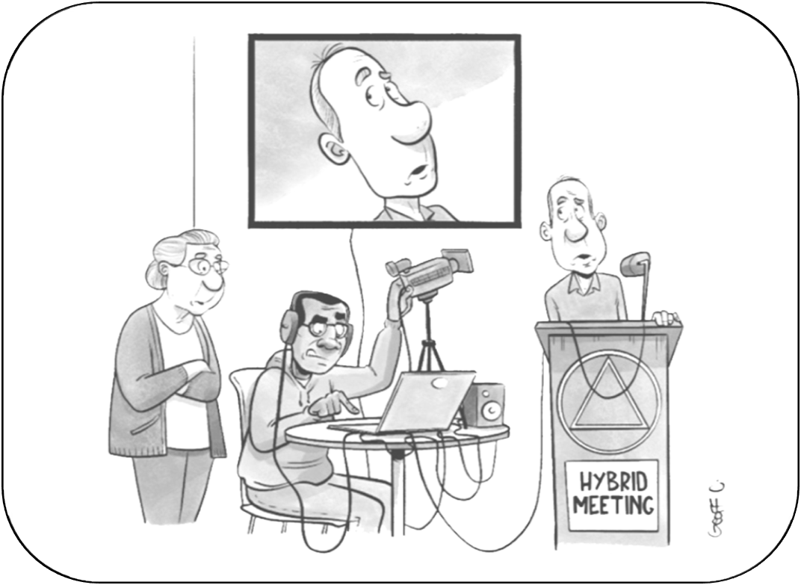
In my day, the most complicated service position was emptying the ashtrays.

Slide 107
Since the last area assembly
Added and updated events on the Area 21 website area21aa.org
Updated plugins and WordPress on Area 21 website
Updated Windows, HP, and Zoom software on Area laptops
Managed Zoom recording files for Area Committees
Uploaded new and deleted old items on Virtual Flyer Table for Assemblies
Created and edited Zoom Meetings for the 2026 Assemblies
Created Zoom polls for this Assembly
Prepared this Slide show

Slide 108
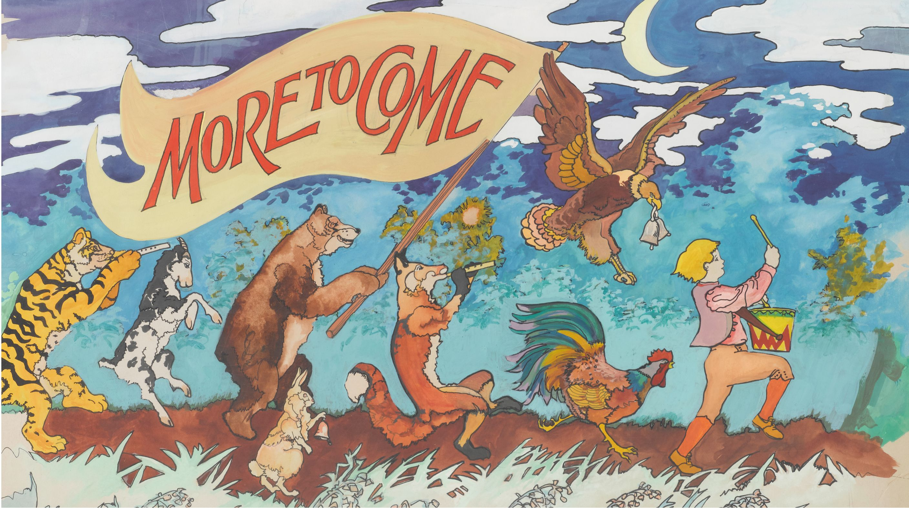
10 MINUTE BREAK

Slide 109
OLD BUSINESS - On the Agenda for a Vote
Report on progress for 2027 ISC

Slide 110
NEW BUSINESS - On the Agenda for a Vote
Bid for hosting PRE-GSC Workshop April 2027

Slide 111
NEW BUSINESS - On the Agenda for a Vote
Area to endorse Here’s How / District 17s. Proposed agenda item.
Guidance is needed in regard to maintaining traditions for social media pages that use the A.A. name.

Slide 112
Here’s How / District 17s. Proposed agenda item.
Delegates should have the opportunity to hear input from their areas before discussion/ voting on proposed changes to the book Alcoholics Anonymous, including it’s first 164 pages, Preface, Forwards, “Doctor’s Opinion,” “Dr. Bob’s Nightmare,” and the Appendices. In addition, Delegates should have the same opportunity for any proposed changes to any text of the book Twelve Steps and Twelve Traditions. Therefore, such items of recommendation can not come solely from the Conference Committees or from floor actions of the GSC. The proposed items would be submitted to the whole fellowship in the proposed conference agenda in a timely manner for review and consideration.

Slide 113
NEW BUSINESS
Motions from the floor. (1)
Requires a 2nd before any discussion.

Slide 114
NEW BUSINESS
Motions from the floor. (2)
Requires a 2nd before any discussion.

Slide 115
CALENDAR REVIEW
For more info & details,
Please Visit our Area 21 website: area21aa.org/events

Slide 116
Bridging the Gap Workshop Weekend September 25-27,2026, Olathe, KS
Tri-State Convention – November 8, 2026,Evansville, IN
National Corrections Conference Nov. 13-15, 2026,
Salt Lake City. UT
Area 21 Assembly – December 13, 2026, D-18 Edwardsville, IL
Conference Past and Present Delegates – Feb. 12 -14, 2027, Milwaukee, WI
ISCYPAA March 5 – 7, 2027 Quincy, IL

Slide 117
Area 21 Assembly – March 2027; D-19 Springfield,
Area 21 Pre-GSC Workshop – To be determined in April 2027
Area 21 Assembly – June 2027; D-15 (Jacksonville?)
East Central Regional Forum June 25-27, 2027, Green Bay. WI
East Central Regional Conference August 20-22, 2027,
Fairborn, OH
Area 21 Assembly – September 2027, D-6 (Peoria)
Illinois State Conference – September 17-19, 2027, O’Fallon, IL

Slide 118

RECOGNITION OF A.A. ANNIVERSARIES
SINCE JUNE 7, 2026

Slide 119
Report On Today’s Assembly
Sept 13, 2026
Warren S. Dist 13 DCM
Leo S. Area 21 Treasurer

Slide 120
RESPONSIBILITY STATEMENT
Who is Resposible???
I am responsible, when anyone, anywhere, reaches out for help,
I want the hand of A.A. always to be there,
and for that I am responsible

